Slide 1


Introduction to Software Business Product Management
Week 2 Day 3
Led by: Emily Crose
for
Oakland University

Slide 2
Day 2 Recap

Slide 3

Questions From Day 2?

Slide 4
Terms To Listen For
Discretionary Access Control (DAC)
A method of access control provisioned by an administrator
Mandatory Access Control (MAC)
Access control provisioned by data labeling
Authentication
Refers to the process of verifying a user’s identity.
Denial of Service
A forced outage of a service based on a misconfiguration or a concerted effort

Slide 5
Anatomy of a Vulnerability

Slide 6


Authentication

Slide 7
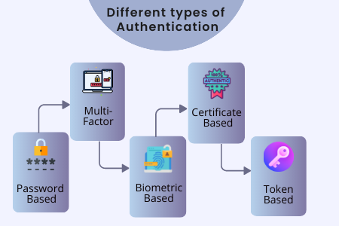

Slide 8

Access Control

Slide 9

MAC, DAC, and RBAC

Slide 10

Mandatory Access Control

Slide 11
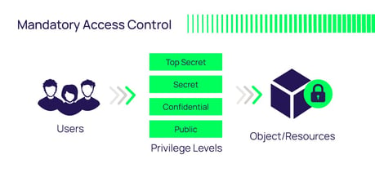
Mandatory Access Control (MAC)
Notes:
The important piece for MAC is that access to a resource is based on the sensitivity label of the information.

Slide 12

Discretionary Access Control (DAC)

Slide 13
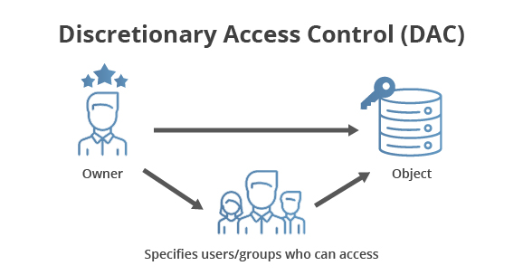
DAC

Slide 14
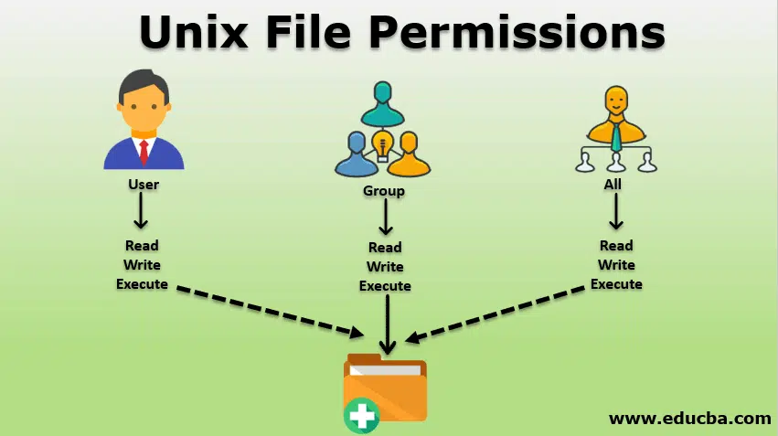
DAC In Action

Slide 15
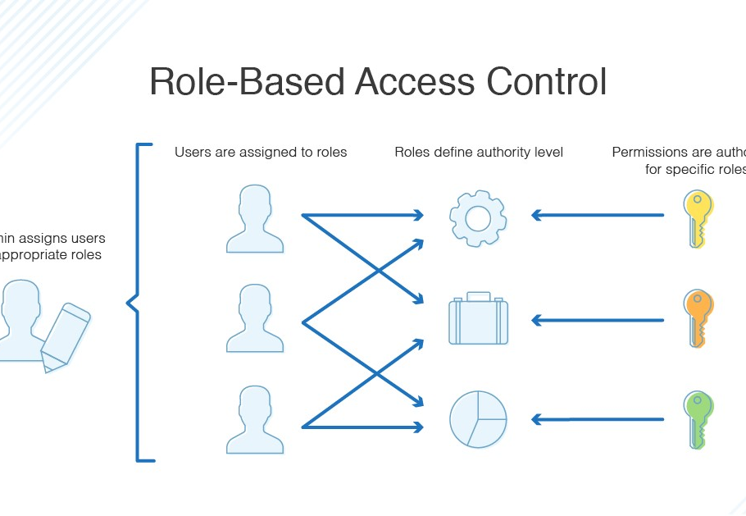
Role Based Access Control (RBAC)

Slide 16
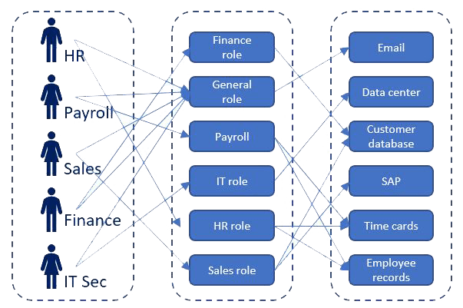
RBAC In Action

Slide 17
Pentesting Methodology

Slide 18
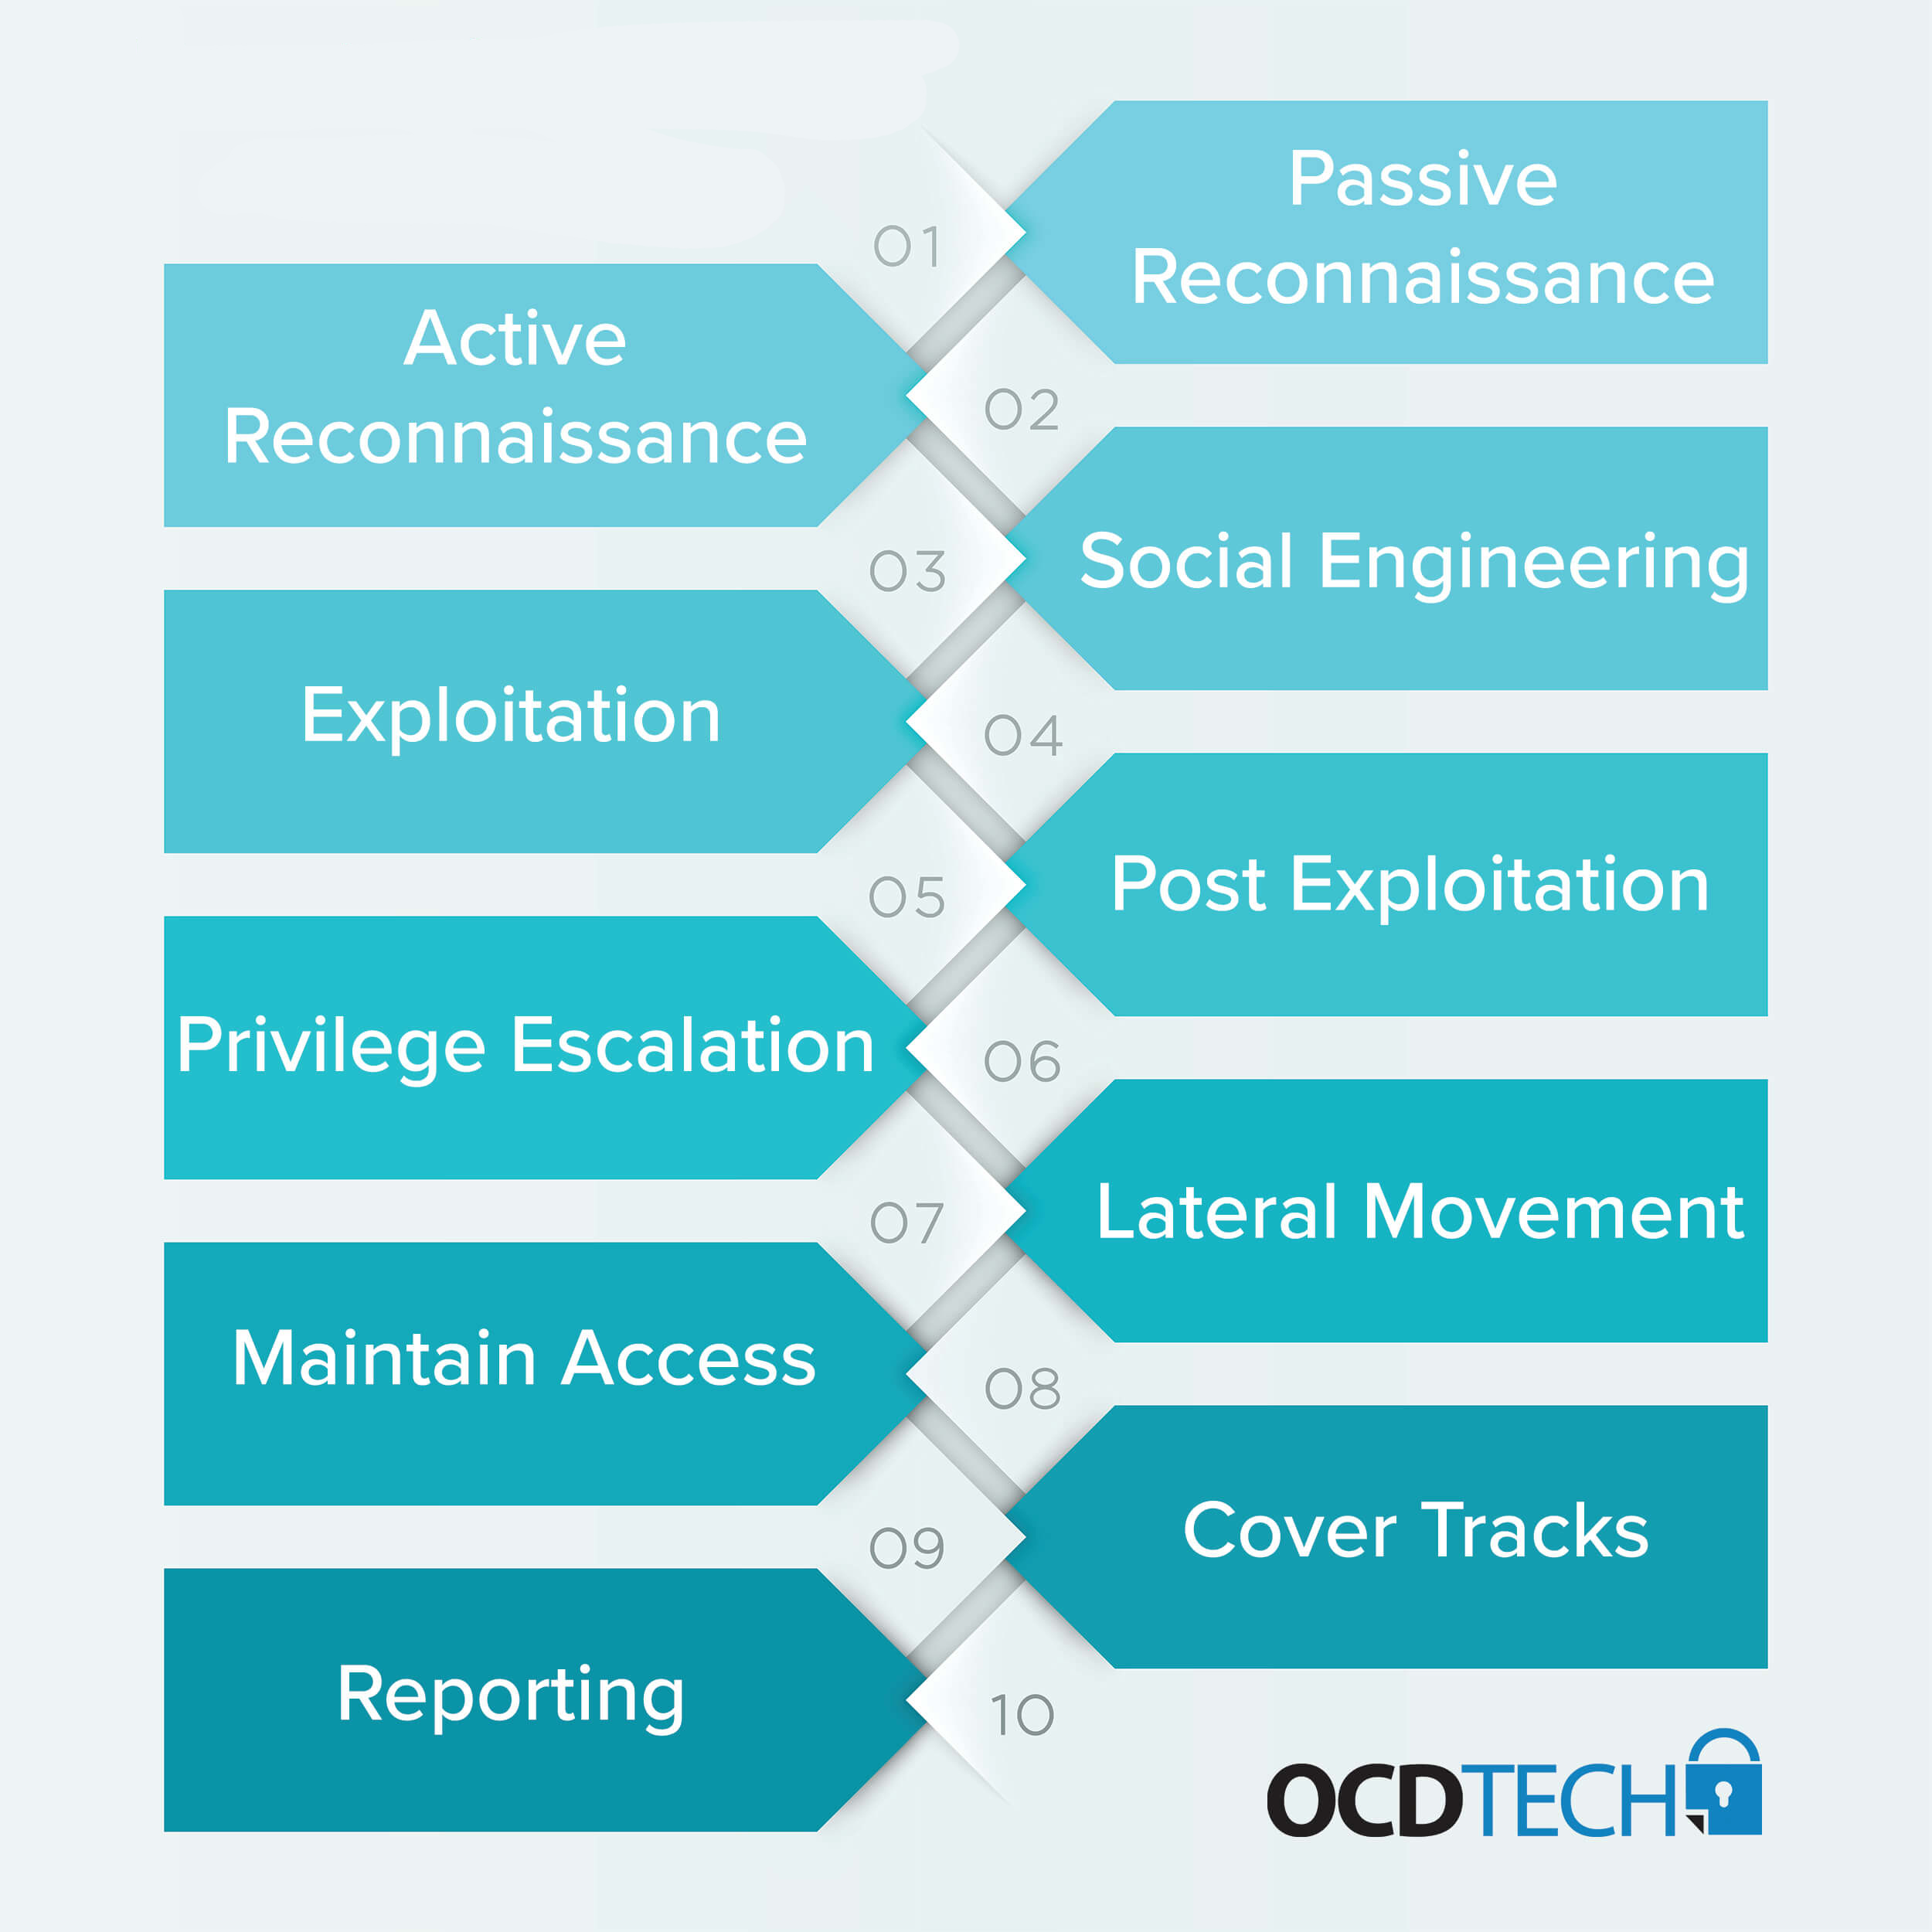

Slide 19
Standards

Slide 20


OWASP

Slide 21
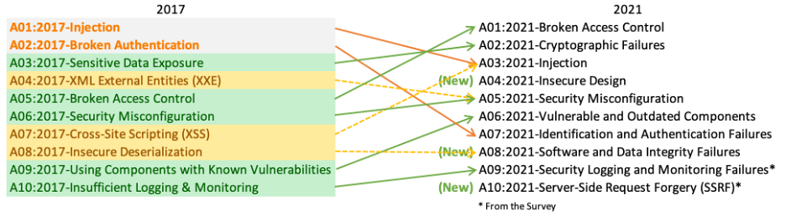
OWASP Top 10

Slide 22

Mobile Application Security Verification Standard (MASVS)
https://github.com/OWASP/owasp-masvs/

Slide 23


Slide 24
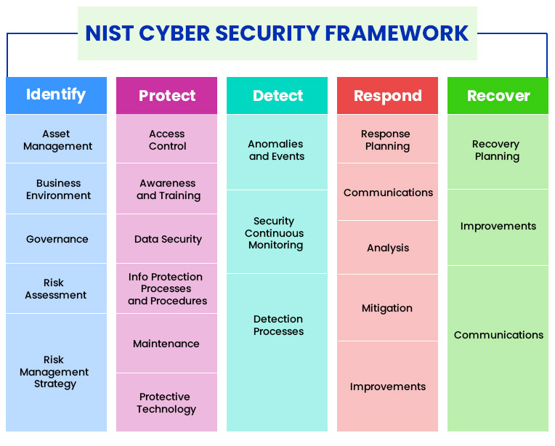
NIST Cybersecurity Framework

Slide 25

10-minute break

Slide 26
Application Programming Interfaces (APIs)
What do they do for applications?
When would we want to use an API?

Slide 27
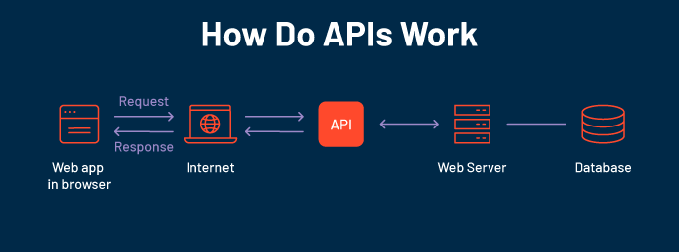

Slide 28
Familiar APIs
Representational State Transfer (REST or RESTful) API
Fast
Reliable
Widely adopted
Simple!
Simple Object Access Protocol (SOAP)
Used in some OT network appliances
Browser API
iOS/Android API
Allows developers the tools they need to utilize local resources in their own programs
Notification API calls
Camera activation
Media integration

Slide 29
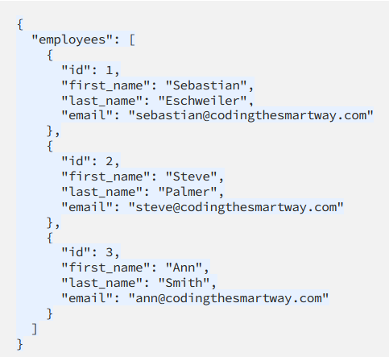
Notes:
Let’s take a look at a JSON form providing us information through an API interface. So when we use an API to retrieve information, we will typically be grabbing that information from a formatted file like a JSON file. We can see from this JSON file that actually this looks kind of like a database file.

Slide 30
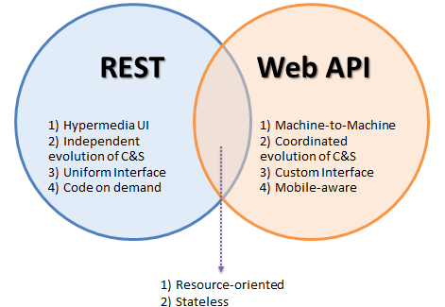
Popular API Frameworks

Slide 31

HTTP/Web API

Slide 32
HTTP API Verbs
HTTP
GET
POST
PUT
DELETE

Slide 33
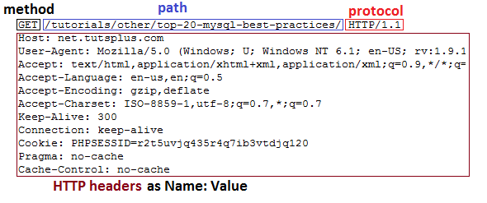
HTTP GET Header

Slide 34
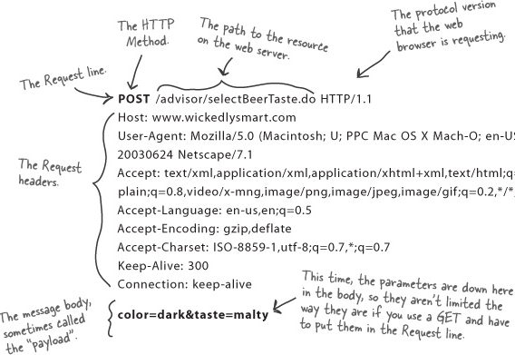
HTTP POST Header

Slide 35
Weather API Documentation
https://rapidapi.com/weatherapi/api/weatherapi-com
Notes:
A word on documentation – we should always start with the documentation when we go to program with an API

Slide 36
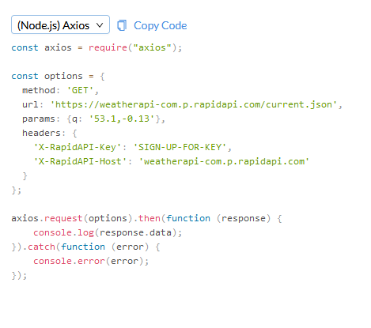
Notes:
So let’s take a look at what an API actually looks like in practice.

Slide 37
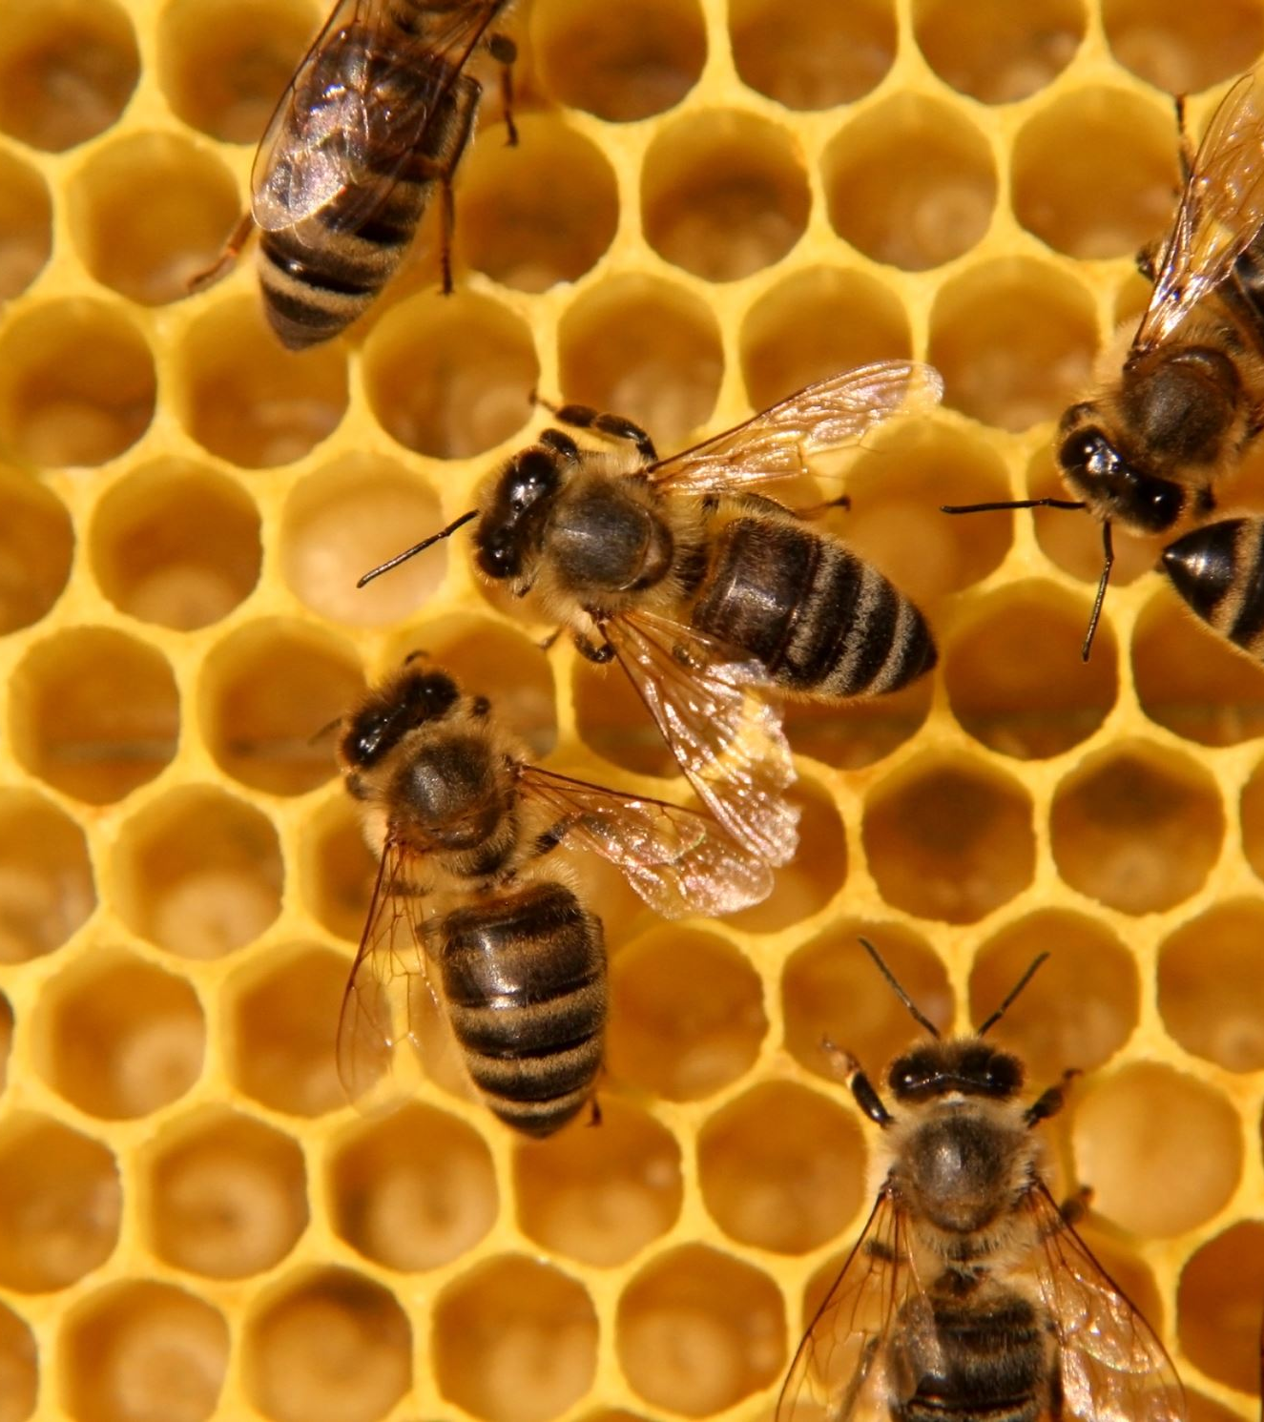
Working With APIs
Can be programmed
Can be used in a raw request

Slide 38
Programming Mobile Apps w/APIs
Android
Kotlin
Apple iOS
SWIFT
Both have access to device APIs!

Slide 39
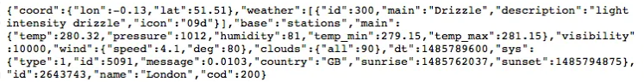
Mobile Device API Example

Slide 40
10 minute break

Slide 41

Securing APIs

Slide 42
SAML vs. Oauth
Security Assertion Markup Language (SAML)
Windows uses this for Single Sign On (SSO)
Integrates with Windows domain
Optimized for enterprise security
Oauth
Optimized for mobile applications
Uses API calls itself!
Tends to play better with mobile & lightweight IoT environments

Slide 43

What is Oauth?

Slide 44
Oauth
Allows one application to validate itself with another application
Uses tokens for authentication
We give applications permission to play with other applications via Oauth
Think of it like a valet for your apps!

Slide 45
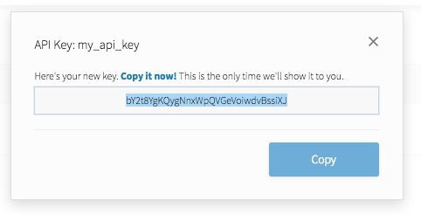
API Key
Notes:
API keys are meant to be kept secret. Why? Because they include information related to one specific account.

Slide 46

Why Do We Need API Keys?
Account verification
Who is requesting what information?
Rate limiting
Avoid denial of service
Permissions
What do we want to allow certain people to see?

Slide 47
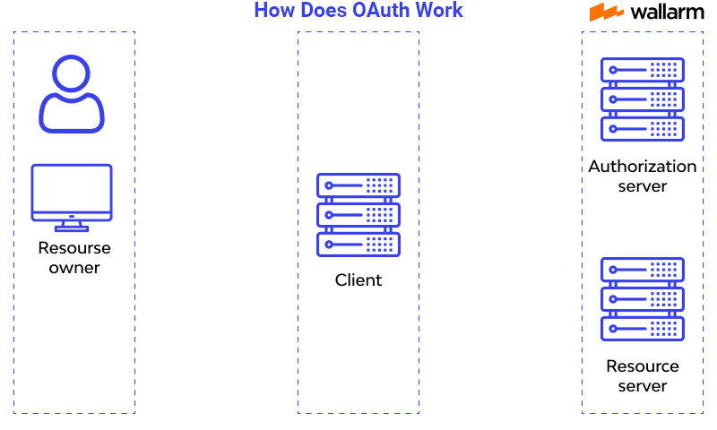
How does OAuth work?

Slide 48

Question or clarifications?

Slide 49

Review Day 3

Slide 50

Preview Week 3

